Slide 1


SONG LIBRARY
SYSTEM
NAME : SANJANA DISAWAL[RA2211056010113]
KOMAL VERMA[RA2211056010140]

Slide 2

PROBLEM DEFINITION
Introduction:
Many music enthusiasts face challenges in organizing and managing their personal music libraries.
Common issues include disorganization, the presence of duplicate songs, and inefficiencies in searching and retrieval.
Problems:
Disorganized Music Collections:
Duplicate Songs:
c. Inefficient Retrieval:

Slide 3

PROBLEM DEFINITION
Disorderly Music Libraries:
Users often struggle with disorganized music collections, hindering the prompt location of specific songs and causing frustration.
Linked List Organization:
Our system introduces a linked list structure, enabling systematic organization by artist, song name, and genre for a more enjoyable user experience.
Duplicate Song Prevention:
The Song Library System incorporates checks to prevent the addition of duplicate songs, ensuring a clean and efficient music library.
Inefficient Retrieval:
Inefficient search and retrieval processes lead to frustration, hindering the overall user experience.

Slide 4
PROBLEM DEFINITION
Streamlined Search Functionality:
Our system offers streamlined search and retrieval functionalities, allowing users to locate songs with ease and efficiency.
Dynamic Data Structure:
A dynamic data structure facilitates organized and efficient management of songs in the library.
Maintaining Pristine Collections:
Checks and balances are implemented to maintain a pristine music collection by preventing the addition of duplicate songs.
Enhanced User Satisfaction:
Intuitive commands enable users to quickly find and retrieve specific songs, enhancing overall user satisfaction.

Slide 5
SOLUTION
Our Song Library System presents a comprehensive solution to the challenges faced by music enthusiasts in managing their personal music libraries.
By addressing issues of disorganization, duplicate songs, and inefficient retrieval processes, our system introduces a streamlined and efficient approach to music library management. Through the implementation of a linked list structure, preventative measures against duplicate entries, and intuitive search functionalities, our solution aims to enhance user satisfaction, ensuring a clean, well-organized, and enjoyable music collection experience.

Slide 6
DATA STRUCTURE USED
Data Structure Used: Linked List
In the Song Library System, we employ a linked list as the fundamental data structure to organize and manage the music library. A linked list is a linear data structure where elements, known as nodes, are stored sequentially. Each node contains both data and a reference or link to the next node in the sequence. This dynamic structure allows for efficient insertion, deletion, and traversal of elements.
Advantages of Using a Linked List:
Dynamic Size:
The linked list accommodates a dynamic size, enabling the system to handle a variable number of songs without the constraints of a fixed-size array.
Efficient Insertion and Deletion:
Adding or removing songs is optimized with the linked list, as it facilitates straightforward insertion and deletion operations without the need to shift elements.

Slide 7
DATA STRUCTURE USED
Flexible Organization:
The linked list's flexibility allows us to organize the music library in a structured manner. Nodes can be arranged based on artist names, song titles, and genres to enhance user navigation.
Streamlined Search:
Searching for specific songs becomes more efficient through traversal of the linked list, as each node contains essential details such as artist, song name, and genre.
Memory Efficiency:
The linked list optimizes memory usage by allocating memory for each node as needed. This contrasts with fixed-size arrays, which may allocate more memory than required.
Dynamic Management:
The dynamic nature of the linked list enables us to manage the music library dynamically, adapting to changes in the collection over time.

Slide 8
ALGORITHM:
Step 1: Declare pointer head and allocate memory for character pointers(song name, artist, genre).
Step 2: Create insert, delete, search, display and quit functions.
Step 3: Print commands or operations.
Step 4: User Input and Command Processing (Loop)
Step 5: Free the allocated memory.
Step 6: Display the required function called.
Step 7: End.

Slide 9
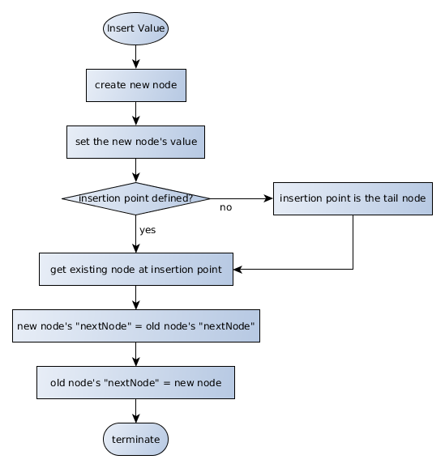
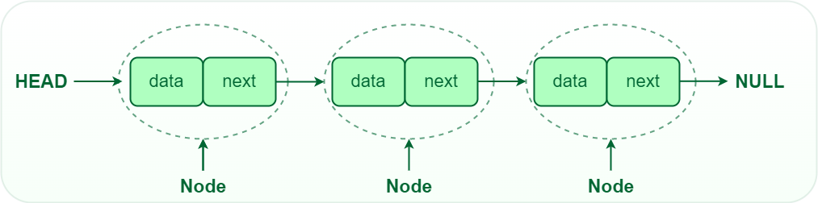
FLOWCHART:

Slide 10
SOURCE CODE
#include <stdio.h>
#include <stdlib.h>
#include <ctype.h>
#include <string.h>
#include <stdbool.h>
// A node in the linked list.
// Each string in the node is declared as a character pointer variable, so they need to be dynamically allocated using the malloc() function,
// and deallocated using the free() function after use.
typedef struct node {
char *artist;
char *songName;
char *genre;
struct node *linkToNextNode;
} Node;
const int MAX_LENGTH = 1024; // The max length of any user input.

Slide 11
// Declarations of linked list functions
void inputStringFromUser(char *prompt, char *s, int arraySize); // Gets input from user.
void songNameDuplicate(char *songName); // Prints a message when a duplicate of the song is found in the library.
void songNameFound(char *songName); // Prints a message when a song name was found in the personal music library.
void songNameNotFound(char *songName); // Prints a message when a song name was not found in the personal music library.
void songNameDeleted(char *songName); // Prints a message when a song was deleted in the personal music library.
void artistFound(char *artist); // Prints a message when a artist name was found in the personal music library.
void artistNotFound(char *artist); // Prints a message when a artist name was not found in the personal music library.
void printMusicLibraryEmpty(void); // Prints a message when the personal music library is empty.
void printMusicLibraryTitle(void); // Prints the title of the music library.
void printMusicLibraryList(Node *head); // Prints the music library (P Command).
void searchForSong(Node *head, char songIntededToBeFound[MAX_LENGTH]); // Searches for the song name in the music library (S Command).
bool songAlreadyInPlaylist(Node *head, char songIntededToBeFound[MAX_LENGTH]); // Boolean function controls the flow of the program depedning on if the song is found.

Slide 12
Node *insertANewNodeInOrder(Node *head, char songName[MAX_LENGTH], char artist[MAX_LENGTH], char genre[MAX_LENGTH]); // Inserts a new node into the music library using linked list (I Command).
Node *deleteTheSong(Node *head, char songIntededToBeDeleted[MAX_LENGTH]); // Deletes a certain song from the music library (D Command).
Node *deleteAllNodesFromLibrary(Node *head); // Deletes the entire music library (Q Command).
int main(void)
{
// Declare the head of the linked list.
Node *head = NULL;
char *songName, *artist, *genre;
artist = (char *) malloc(MAX_LENGTH * sizeof (char));
genre = (char *) malloc(MAX_LENGTH * sizeof (char));
songName = (char*) malloc(MAX_LENGTH * sizeof (char));
// Announce at the start of the program
printf("\tPersonal Music Library.\n\n"); printf( "ORGANISE YOUR SONG LIBRARY:\n\nInsert a new song \t\t(I)\nDelete a song \t\t\t(D)\nSearch for a song \t\t(S)\nSongs in library\t\t(P)\n EXIT\t\t\t\t\t(Q)\n");

Slide 13
char response;
char input[MAX_LENGTH + 1];
do
{
inputStringFromUser("\nEnter action to perform:", input, MAX_LENGTH); // Response is the first character entered by user.
response = toupper(input[0]); // Convert to uppercase to simplify later comparisons.
if (response == 'I') // Insert a song into the linked list and order it alphabeticallly by song name.
{
char *promptName = "Song name";
char *promptArtist = "Artist";
char *promptGenre = "Genre";
inputStringFromUser(promptName, songName, MAX_LENGTH);
inputStringFromUser(promptArtist, artist, MAX_LENGTH);
inputStringFromUser(promptGenre, genre, MAX_LENGTH);

Slide 14
if (!songAlreadyInPlaylist(head, songName))
{
head = insertANewNodeInOrder(head, songName, artist, genre);
}
else
{
songNameDuplicate(songName);
}
}
else if (response == 'D') // Delete a song from the list.
{
char *prompt = "\nEnter the name of the song to be deleted";
inputStringFromUser(prompt, songName, MAX_LENGTH);
head = deleteTheSong(head, songName);
}
else if (response == 'S') // Search for a song by its name.
{
char *prompt = "\nEnter the name of the song to search for";

Slide 15
inputStringFromUser(prompt, songName, MAX_LENGTH);
searchForSong(head, songName);
}
else if (response == 'P') // Print the music library.
{
printMusicLibraryList(head);
}
else if (response == 'Q') // do nothing, we'll catch this below
{
;
}
else // do this if no command matched ...
{
printf ("\nInvalid command.\n");
}
} while (response != 'Q'); // Delete the entire linked list.
head = deleteAllNodesFromLibrary(head);
printMusicLibraryList(head); // Print the linked list to confirm deletion.
return 0;
}

Slide 16
// The following are the function definitions for the declared variables used in the main code.
// Prompt the user for a string safely, without buffer overflow
void inputStringFromUser(char *prompt, char *s, int maxStrLength)
{
int i = 0;
char c;
printf("%s --> ", prompt);
while (i < maxStrLength && (c = getchar()) != '\n')
s[i++] = c;
s[i] = '\0';
}
// Function to call when the user is trying to insert a song name that is already in the personal music library.
void songNameDuplicate(char *songName)
{
printf("\nA song with the name '%s' is already in the music library.\n"
"No new song entered.\n", songName);
}

Slide 17
// Function to call when a song name was found in the personal music library.
void songNameFound(char *songName)
{
printf("\nThe song name '%s' was found in the music library.\n\n", songName);
}
// Function to call when a song name was not found in the personal music library.
void songNameNotFound(char *songName)
{
printf("\nThe song name '%s' was not found in the music library.\n", songName);
}
// Function to call when a song name that is to be deleted in the personal music library.
void songNameDeleted(char *songName)
{
printf("\nDeleting a song with name '%s' from the music library.\n", songName);
}
// Function to call when printing an empty music library.
void printMusicLibraryEmpty(void) {
printf("\nThe music library is empty.\n");
}

Slide 18
// Function to call to print a title when the entire music library is printed.
void printMusicLibraryTitle(void)
{
printf("\nMy Personal Music Library: \n");
}
// This function is for printing the linked list (the P command).
void printMusicLibraryList(Node *head)
{
Node *current = head;
if (current == NULL)
{
printMusicLibraryEmpty();
}
else
{
printMusicLibraryTitle();

Slide 19
while (current != NULL)
{
printf("\n");
printf("%s\n", current -> songName);
printf("%s\n", current -> artist);
printf("%s\n", current -> genre);
current = current -> linkToNextNode;
}
}
}
// This function searches the linked list for a given song name and then either prints the appropriate song or, if a node is not found, prints an error message (S command)
void searchForSong(Node *head, char songIntededToBeFound[MAX_LENGTH])
{
if (head == NULL)
{
return;
}
Node *current = head;
while (current != NULL)

Slide 20
{
if (strcmp(current -> songName, songIntededToBeFound) == 0)
{
songNameFound(songIntededToBeFound);
printf("%s\n", current -> songName);
printf("%s\n", current -> artist);
printf("%s\n", current -> genre);
return;
}
current = current -> linkToNextNode;
}
songNameNotFound(songIntededToBeFound);
return;
}
// This function checks if the song is already in the playlist.
bool songAlreadyInPlaylist(Node *head, char songIntededToBeFound[MAX_LENGTH])
{
if (head == NULL)
{
return false;
}

Slide 21
Node *current = head;
while (current != NULL)
{
if (strcmp(current->songName, songIntededToBeFound) == 0)
{
return true;
}
current = current -> linkToNextNode;
}
return false;
}
// This is the function for inserting a new node (the I command) into the linked list.
Node *insertANewNodeInOrder(Node *head, char songName[MAX_LENGTH], char artist[MAX_LENGTH], char genre[MAX_LENGTH])
{
Node *linkToNextNode = head;
if (head == NULL || strcmp(head -> songName, songName) > 0)
{
Node *insert = (Node *) malloc( sizeof(Node));

Slide 22
insert -> songName = (char *) malloc(MAX_LENGTH * sizeof(char));
insert -> artist = (char *) malloc(MAX_LENGTH * sizeof(char));
insert -> genre = (char *) malloc(MAX_LENGTH * sizeof(char));
if (insert != NULL)
{
strcpy(insert -> songName, songName);
strcpy(insert -> artist, artist);
strcpy(insert -> genre, genre);
insert -> linkToNextNode = linkToNextNode;
}
return insert;
}
Node *current = head;
while (current -> linkToNextNode != NULL && strcmp(current -> linkToNextNode -> songName, songName) < 0)
{
current = current -> linkToNextNode;
}

Slide 23
Node *insert = (Node *) malloc(sizeof (Node));
insert -> songName = (char *) malloc(MAX_LENGTH * sizeof (char));
insert -> artist = (char *) malloc(MAX_LENGTH * sizeof (char));
insert -> genre = (char *) malloc(MAX_LENGTH * sizeof (char));
if (insert != NULL)
{
strcpy(insert -> songName, songName);
strcpy(insert -> artist, artist);
strcpy(insert -> genre, genre);
insert -> linkToNextNode = linkToNextNode;
}
current -> linkToNextNode = insert;
return head;
}
// This function is for deleting a song from the personal music library.
Node *deleteTheSong(Node *head, char songIntendedToBeDeleted[MAX_LENGTH])

Slide 24
{
if (head == NULL)
{
return NULL;
}
// If the first node is to be deleted
if (strcmp(head -> songName, songIntendedToBeDeleted) == 0)
{
Node *secondNode = head -> linkToNextNode;
songNameDeleted(head -> songName);
free(head -> songName);
free(head -> artist);
free(head -> genre);
free(head);
return secondNode;
}
bool foundTheSong = false;
Node *current = head;
while (!foundTheSong && current -> linkToNextNode != NULL)
{

Slide 25
if (strcmp(current -> linkToNextNode -> songName, songIntendedToBeDeleted) == 0)
{
foundTheSong = true;
}
else
{
current = current -> linkToNextNode;
}
}
// if there exists a node to be deleted
if (current -> linkToNextNode != NULL)
{
Node *songToRemove = current -> linkToNextNode;
current -> linkToNextNode = current -> linkToNextNode -> linkToNextNode;
songNameDeleted(songToRemove -> songName);
free(songToRemove -> songName);
free(songToRemove -> artist);
free(songToRemove -> genre);
free(songToRemove);
}
return head;

Slide 26
}
// This function is for executing when the Q command is entered.
Node *deleteAllNodesFromLibrary(Node *head)
{
if (head == NULL)
{
return head;
}
while (head != NULL)
{
Node *firstNode = head;
head = head -> linkToNextNode;
songNameDeleted(firstNode -> songName);
free(firstNode -> songName);
free(firstNode -> artist);
free(firstNode -> genre);
free(firstNode);
}
return head;
}

Slide 27
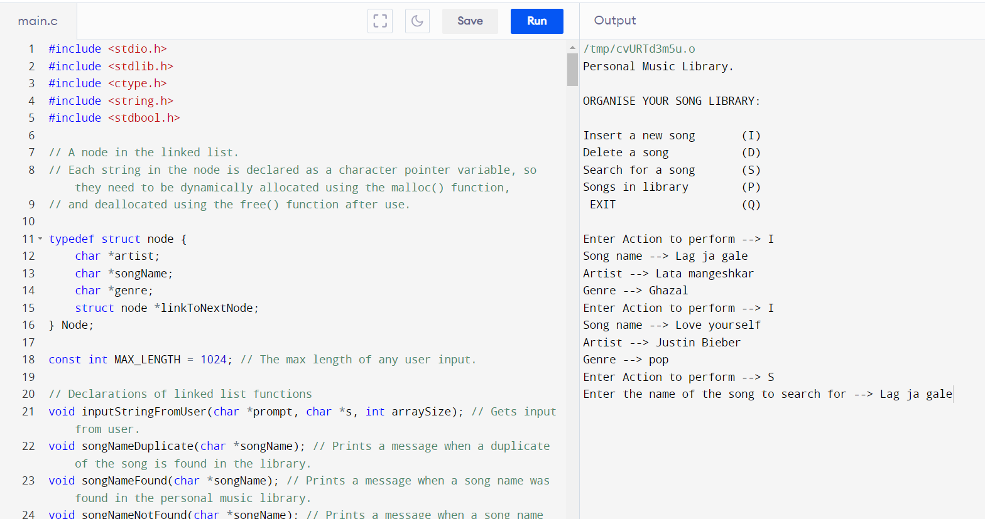
OUTPUT:

Slide 28
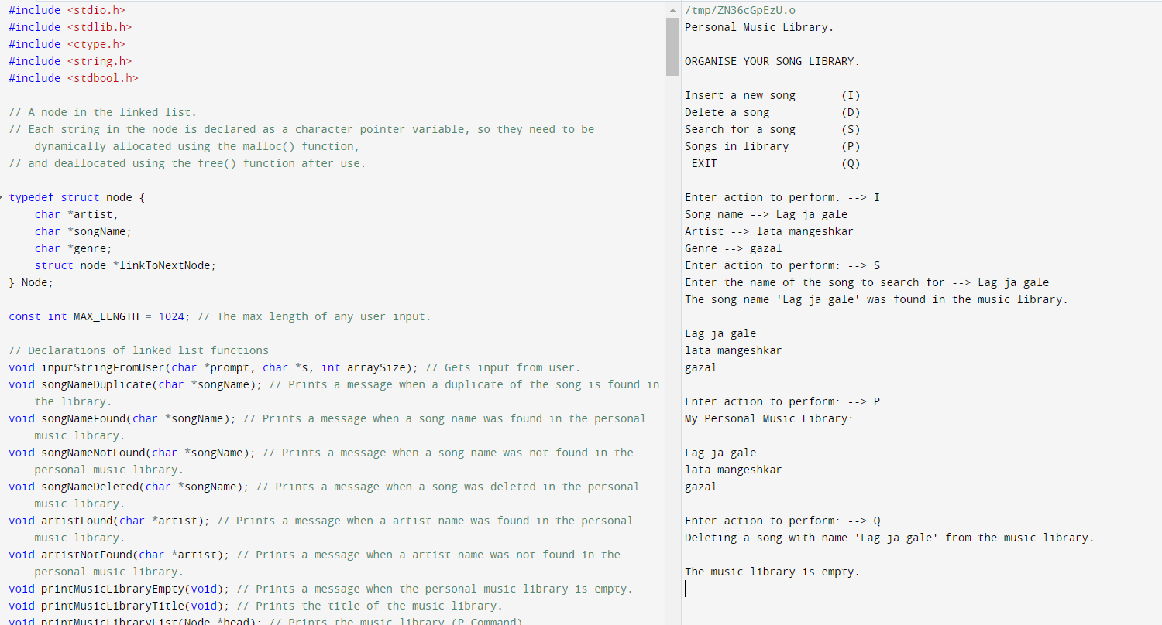
OUTPUT:

Slide 29
SUMMARY
The Song Library System offers a comprehensive solution to the challenges faced by music enthusiasts in managing their personal music libraries. By leveraging a linked list as the underlying data structure, the system provides dynamic and efficient organization, allowing users to navigate their collections seamlessly.
Addressing the issues of disorganization, duplicate songs, and inefficient retrieval, our solution introduces streamlined search functionalities and preventative measures against duplicate entries. The linked list's dynamic size and efficient insertion and deletion operations accommodate the evolving nature of music libraries, optimizing memory usage and facilitating flexible organization.
In summary, the Song Library System not only enhances the organization and cleanliness of music collections but also prioritizes user satisfaction by providing an intuitive, efficient, and enjoyable music library management experience.

Slide 30
THANKYOU
SANJANA DISAWAL
KOMAL VERMA

